Slide 1
ITSM – Session 4
Dr. Phalachandra HL
Acknowledgements:
Significant portions of the information in the slide sets presented through the course in the class are extracted from IT Systems Management -Rich Schiesser and other books/Internet. Since these were intended for presentation in the class room for teaching, instructor resources has been requested from the publisher, but not received yet. I would like to sincerely thank, acknowledge and reiterate that the credit/rights remain with the original authors/publishers only

Slide 2
Availability Management
BITS Pilani, Deemed to be University under Section 3 of UGC Act, 1956

Slide 3
IT Systems Management
Recap - 1
IT infrastructure includes all of Physical devices and software in an IT environment required to operate an enterprise, like the Servers, Disk Storage, DBs, Networks and Desktop environments
IT Infrastructure Systems Management involves building processes which can manage the IT Services running on these IT environment components (for its customers), and providing a stable and responsive IT environment, which supports or furthers the Business of the organization, while being Available, Responsive, Cost efficient, Secure, Scalable,…
ITSM would need support from executives in-terms of IT budget, resources, mindshare etc. Support is obtained through business case and then structuring the organization well, and positioning the processes in the organization for efficient and effective execution

Slide 4
IT Systems Management
Recap -2
One of the critical success factors for ITSM are people. These could be in terms of process owners and the people who form the process teams. We discussed on mechanisms for staffing, engaging and retaining people. We also discussed on the fallibility of these senior people due to different personal and Business ethics which could breach the commonly accepted values and behaviors leading to corporate frauds and abuse like the Enron, Tyco etc. and looked at the legislations (like Sarbanes-Oxley Act) which have come into being to address some of these and how this has a relationship to IT executive behaviors and its impact on the IT infrastructure
We discussed on ITSM best practices shared through de-facto standards like ITIL associated with these processes.
We also discussed the evolution of ITIL to the Service Lifecycle and the current ITIL 4.

Slide 5
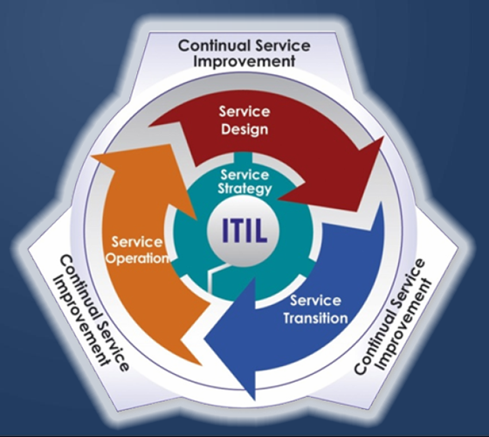
IT Systems Management
Recap -3
We discussed the Service Life cycle as below
Service strategy (Aligns the IT department to the core Business):
Provides guidance towards deciding on a strategy to serve customers.
Service design (Design of new services, as well as changes and improvements to existing ones ):
Turns the service strategy into a plan for delivering the business objectives, technology service delivery.
Service transition (Moving from a development phase to a operation phase):
Develops and improves capabilities for introducing new services into supported environments
Service operation (Ensuring that the services are delivered at an agreed upon service level):
Manages services in supported environments.

Slide 6
IT Systems Management
Recap -4
We also discussed on the relevance of being customer centric how the IT systems management processes evolved to provide customer centric services, the key elements of providing good customer services and an approach to get to good customer service.
The four elements of good customer service:
Identifying key customers
Identifying key services of key customers
Identifying key processes that support key services
Identifying key suppliers that support key processes
Key Customers
Key Services
Key Processes
Key
Suppliers
Reasonable Expectations Met
Critical to Customers Success
Adds
Value
Provides High-Quality Input

Slide 7
IT Systems Management
We discussed that there were 12 key processes which we would discuss as part of IT Systems management as part of the course
Availability Management
Performance/Tuning
Production Acceptance
Change Management
Problem Management
Storage Management
Availability Management is the first of the key Infrastructure process used in IT Systems Management
Network Management
Configuration Management
Capacity Planning
Security
Business Continuity
Facilities Management

Slide 8
IT Systems Management
What does IT infrastructure Availability mean to you?

Slide 9
Definition
We can consider that a system/process when up and running is available, and if its not running (regardless of the reason), the system/process is not available.
The focus for maximizing Availability would be for timely recovery from outages to service, and methods to reduce the frequency and duration of these outages
Defn Availability:
Availability is the probability that a system or the IT services will work as required (may be driven by SLAs), when required, during the period when it needs to be used for a purpose.
Availability process as a system management process, is the process of optimizing the readiness of production systems by accurately measuring, analyzing, managing and reducing outages to those production systems and services to meet expectations.
Notes:
Professional response to outages
Mission critical Business
Defn Uptime:
Is a measure of the time that the individual components within a production system are functionally operating

Slide 10
IT Systems Management
What does IT Infrastructure Availability Management mean to you?

Slide 11
Goal of IT Infrastructure Availability Management could be
To meet/exceed the expected/agreed/guaranteed levels of functioning of the Services and Systems :
In a cost-effective manner
In a consistent manner
In a timely manner
Providing a single point of contact for all of the systems and processes which have a play towards Availability
Supporting the meeting of both the current and future availability needs of the business

Slide 12
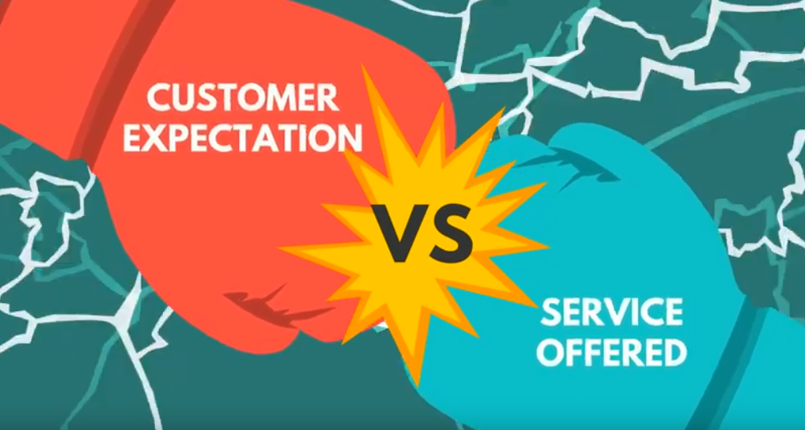
ITSM : Availability Management
Summarily the challenge here is to ensure
Notes:
Is your mail server running, DB server, Router, Switches .. All IT services covered in SLA is available .. Lot more .. Guarantee all of the services

Slide 13
Differentiating Availability from Uptime
Availability, is oriented towards the users (customers of an IT Infrastructure management system), and is the assurance that, the application system which the users need for their job, is available to them when they need it.
Uptime is oriented towards the Service provider (Supplier of the IT Infrastructure management system or the IT organization) and is the assurance or the measure of the time that the individual components of the system which make up the IT Infrastructure are functionally operating
There can be a lot of components like Datacenter facility, Server H/W components, Server System SW components, Application S/W, Disks Subsystems HW, DB or Network HW, Network SW, Desktop HW, Desktop SW which can potentially fail and reduce Availability
IT Systems management folks face two dilemmas/challenges while managing Availability in terms of
Trading the costs of outages of components (and system) against the costs of total redundancy
Accountability challenges due to having multiple components corresponding to multiple process owners
Identifying a process owner responsible for overall availability across different components of the Datacenter would be ideal for effective Availability management

Slide 14
Differentiating Slow Responses from Downtime
Downtime refers to the total inoperability of a hardware device, a software routine, or some other critical component of a system that results in the outage of a production application
Slow or non-responsiveness refers to a service e.g. a transaction taking unacceptably long periods of time for processing and returning the response to the user (depending on the transaction)
Slow response is usually a performance and tuning problem, or a capacity planning problem requiring specialized expertise to look at.
Typically occurs due to growth of DB, traffic on the Network, Contention of Disk volumes, Disabling of processors etc.
Slow responses can infuriate users and frustrate infrastructure specialists.

Slide 15
High Availability
High Availability:
High availability refers to the design of a production environment such that all single points of failure are removed through redundancy, to eliminate production outages.
This involves designing the IT Infrastructure to have virtually no downtime
Fault Tolerance:
Fault tolerance refers to a production environment in which all hardware and software components are duplicated such that they can automatically fail-over to their backup component in the event of a fault. This is to support High Availability as above

Slide 16
Different Approaches towards Availability Management
Proactive approach of Availability Management:
Involves proactive planning, design and activities/work necessary to ensure the new or changed services can and will deliver the agreed levels of availability and appropriate measurements are in place.
Performing risk assessment and management activities to ensure the prevention and or recovery from service and component unavailability
Reactive approach of Availability Management:
Work to ensure that current operational services and components deliver the agreed levels of availability and to respond appropriately when they do not
Involves monitoring, measuring and investigating and analyzing all events, incidents, service and component unavailability etc. for availability and instigating remedial action.

Slide 17
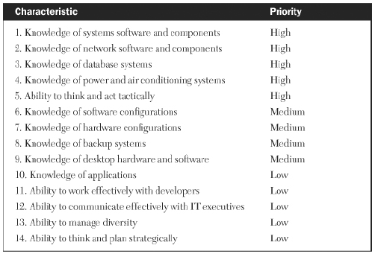
Desired Traits of Availability Process Owner
IT organizations with focus on availability, should choose a single individual (could be called availability process owner or operations manager or technical lead) to own the overall availability process. Some of the sample characteristics of such a role would be

Slide 18
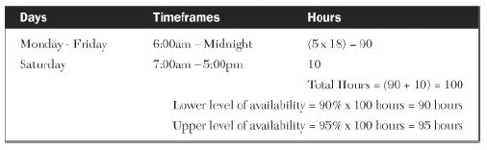
Methods of Measuring Availability
Percentage of system availability
Common approach to measure Availability which is found in SLAs (Service-level agreements)
It’s got by dividing the amount of actual time a system was available by the total time it was scheduled to be up. Percent Availability (Uptime) = (Hours Agreed Up - Hours Down)/Hours Agreed Up
Customers started with expectations of availability in terms of percentage at 90% say for 24/7 operations and moved to …
 | 90 | 99 | 99.9 | 99.99 | 99.999
Per Week in Hrs | 16.8 | 1.68 | 0.168 | 0.0168 | 0.00168
Per Week in Secs | 1008 | 100.8 | 10.08 | 1.008 | 0.1008
Per Day in Sec | 144 | 14.4 | 1.44 | 0.144 | 0.0144
Notes:
The Percent availability (sometimes looked as percent uptime from a service provider perspective) started with expectations of being
90 99 99.9 99.99 99.999
Per Week in Hrs 16.8 1.68 0.168 0.0168 0.00168
Per Week in Secs 100.8 10.08 1.008 0.1008
Per Day 2.4 14.4 1.44 0.144 0.0144

Slide 19
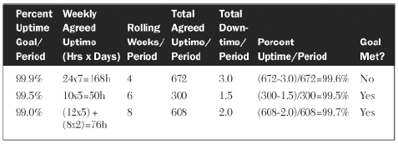
Methods of Measuring Availability
The Rolling average In this approach instead of calculating for a week, the goal is rolled across a few weeks period and then looked to see if it met the Availability criteria and using the same expression
Percent Availability (Uptime) = (Hours Agreed Up - Hours Down)/Hours Agreed Up

Slide 20
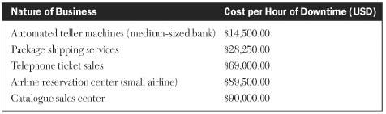
Methods of Measuring Availability
Downtime
Another approach is to track the quantum of downtime and hence the Availability occurring on a daily, weekly, and monthly basis.
Infrastructure personnel can pinpoint and proactively correct problem areas by analyzing the trends, patterns, and relationships of these downtimes
Infrastructure personnel can also track several of the major components like the server environment, the disk storage environment, databases and networks
Improving levels of availability often involves capital expenditures which most companies are reluctant to invest in unless a strong, convincing business justification is offered like the cost of downtime below

Slide 21
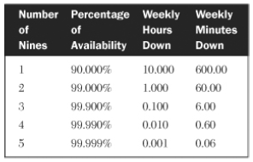
Methods of Measuring Availability
Rule of Nine
Significant number of service suppliers measure their availability in percentages of uptime as the rule of 9s. If you have a working week of 100 hours or working hours of 24x7
This is the percentage of System Availability time but specified in 9s.
 | Per Week in Hrs | Per Week in Secs | Per Day in Sec
90 | 16.8 | 1008 | 144
99 | 1.68 | 100.8 | 14.4
99.9 | 0.168 | 10.08 | 1.44
99.99 | 0.0168 | 1.008 | 0.144
99.999 | 0.00168 | 0.1008 | 0.0144

Slide 22
Methods of Measuring Availability
Approaches used by some of the cloud service providers to measure availability
Microsoft cloud services : time when the overall service is up, divided by total time.
Gmail : percentage of successful interactive user requests for uptime error rate & consecutive minutes of downtime for downtime.
Amazon Web Services : error rate - average percentage of requests that result in errors in a 5-minute interval.
Recent published work also use approaches as “Windowed user-uptime”¹ factoring in user perceived availability over many windows to distinguish between many short periods of unavailability and fewer longer periods of unavailability.

Slide 23
The Seven Rs of High Availability
Goal of availability process owners will be to maximize the uptime of the various online systems for which they are responsible and make them fault tolerant with minimal impact to the budget
The challenges towards a 100% Available system are the Budget, Component failures, Faulty code, Human error, Flawed design, Natural disasters, Unforeseen business shifts like mergers, downturns, political changes
There are several approaches which has been taken to maximize availability for extending uptime, minimizing downtime, and improving the overall level of service. These are referred to as 7 Rs
Redundancy
Reputation
Reliability
Repairability
Recoverability
Responsiveness
Robustness

Slide 24
The Seven Rs of High Availability
Redundancy
This is practiced by Manufacturers by designing this into products. E.g. Power supplies, Multiple processors, Segmented memory, Redundant disks etc.
This can also refer to entire server systems running in a hot standby mode. Infrastructure analysts can take a similar approach by configuring disk and tape controllers, and servers with dual paths, splitting network loads over dual lines, and providing alternate control consoles—in short, eliminate as much as possible any single points of failure that could disrupt service availability
Reputation
To build IT environment using products like Servers, disk storage systems, network hardware etc from suppliers of repute. Reputation refers to the track record of key suppliers
Reputation can be validated with percent of Market share, Industry analyst reports, Track record of reliability, customer references (which can also confirm factors as cost, service, quality of the product, training of service personnel, and trustworthiness)
Reliability
Reliability pertains to the dependability of the components to function under the stated conditions.
It depends on the process which has gone into building the same ..
This can be verified from customer references and industry analysts. (cont.)

Slide 25
The Seven Rs of High Availability
Reliability (Contd.)
Reliability can also be verified using the empirical component reliability analysis by following the 7 steps
Review and analyze problem management logs.
Review and analyze supplier logs.
Acquire feedback from operations personnel.
Acquire feedback from support personnel.
Acquire feedback from supplier repair personnel.
Compare experiences with other shops.
Study reports from industry analysts.
An analysis of problem logs should reveal any unusual patterns of failure and should be studied by supplier, product, using department, time and day of failures, frequency of failures, and time to repair.
A common metric for reliability of components, applications or systems is the average or mean time between failures (MTBF). This is a measure of the average length of time an entity is expected to stay up and operational over a given period of time; this timeframe is often a year and it’s known as the sampling interval. The formula used to compute MTBF is:
MTBF = sampling interval / # of failures during sampling interval

Slide 26
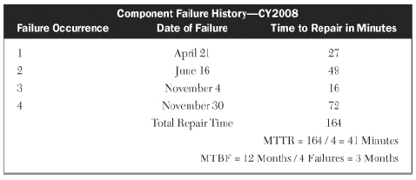
The Seven Rs of High Availability
Repairability
It’s a measure of how quickly and easily suppliers can fix or replace failing parts
Availability could be increased by planning for increased repairability or reducing MTTR
MTTR (Mean time to Repair or Recover or Restore or Resolve) is a common metric used to evaluate this trait and measures the average time it takes to do the actual repair
Its computed as: MTTR = sum of repair times / # of failures

Slide 27
The Seven Rs of High Availability
Recoverability
This refers to the ability to overcome a momentary failure in such a way that there is no impact on end-user availability.
It could be across the spectrum from a single bit error recovery to a having an entire server system switch over to its standby system with no loss of data or transactions.
Recoverability also includes retries of attempted reads and writes out to disk or tape, as well as the retrying of transmissions down network lines.
This could also includes mechanisms of acknowledgements used to ensure missing or non-ordered delivery of sequence of data in protocols like TCP
Responsiveness
Its the sense of urgency all people involved with high availability need to exhibit in terms of quickness and efficiency when needing to respond to problems
This could also be how quickly automated recovery systems get triggered for action to restore availability

Slide 28
The Seven Rs of High Availability
Robustness
It describes the overall design of the availability process to withstand a variety of forces—both internal and external—that could easily disrupt and undermine availability in a weaker environment
Robustness is achieved through documentation and training to withstand
Technical challenges related to Platforms, Products, Services, Customers
Personnel changes as they relate to turnover, expansion and Rotation
Business changes as they relate to New direction, Acquisitions, Mergers
Resilience :
If the system has some of the ML capabilities to learn based on patterns and adapt to the changes

Slide 29
Availability Management Techniques
Techniques that have being used to understand the reason for the disruption of availability
Component Failure Impact Analysis :
Component Failure Impact Analysis (CFIA) can be used to predict and evaluate the impact on IT service arising from component failures within the technology. The output from a CFIA can be used to identify where additional resilience should be considered to prevent or minimize the impact of component failure to the business operation and users
Single Point of Failure analysis
A Single Point of Failure (SPoF) in any component within the IT infrastructure that has no backup or fail-over capability, has the potential to cause disruption to the business, customers or users when it fails. It is important that no unrecognized SPoF’s exist within the IT infrastructure design or the actual technology, and that they are avoided wherever possible. If the system has some of the ML capabilities to learn based on patterns and adapt to the changes

Slide 30
Availability Management Techniques
Techniques that have being used to understand the reason for the disruption of availability (Contd)
Fault Tree Analysis Fault Tree Analysis (FTA) :
Its a technique that can be used to determine the chain of events that causes a disruption to IT services. FTA, in conjunction with calculation methods, can offer detailed models of availability.
Operations can be performed on the resulting fault tree; these operations correspond with design options

Slide 31
Assessing an Infrastructure’s Availability Process
One of the simple methods which has been used to asses and evaluate the quality, efficiency and effectiveness of the Availability processes is through a worksheet, which is filled up by appropriate individuals in collaboration with the process owners and their managers.
There are 10 categories or key measures or characteristics about a Process. These could be categorized into the three objectives of Quality, Efficiency and Effectiveness
Quality
Executive support
Process owner
Process documentation
The degree to which each characteristic is put to use in designing and managing a process is a good measure of its relative robustness
Efficiency
Supplier Involvement
Process metrics
Process integration
Streamlining/automation
Effectiveness
Customer involvement
Service metrics
The training of staff
Notes:
Executive Support - 2
Process Owner - 4
Process Documentation – 1
Quality of Availability Process -7
Efficiency – 3 + 3 + 2 + 1 = 9
Effectiveness = 4+4+ 2= 10

Slide 32
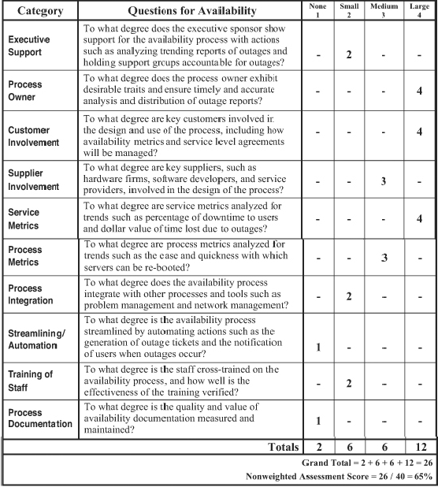
Assessing an Infrastructure’s Availability Process
Quality
Executive support
Process owner
Process documentation
Efficiency
Supplier involvement
Process metrics
Process integration
Streamlining/automation
Effectiveness
Customer involvement
Service metrics
The training of staff
Characteristics within each category is rated on a scale of 1 to 4 with 1 indicating no presence and 4 indicating a large presence of the characteristic.
Notes:
Executive Support - 2
Process Owner - 4
Process Documentation – 1
Quality of Availability Process -7
Efficiency – 3 + 3 + 2 + 1 = 9
Effectiveness = 4+4+ 2= 10

Slide 33
Assessing an Infrastructure’s Availability Process (Contd.)
Since all categories are rated in the same fashion, a single column could have been used to record the ratings of each category
if we format separate columns for each of the four possible scores, categories scoring the lowest and highest ratings stand out visually and quantifies areas of strength and weakness for a given process
This also acts as a benchmark from where future process refinements can be quantitatively measured and compared
The score of a particular process can be compared to those of other infrastructure processes to determine which ones need most attention
Many infrastructures do not attribute the same amount of importance to each of the 10 categories within a process. This can be introduced as a refinement into the work sheet to account for this uneven distribution of category significance by the introduction of a weightage to each of the categories.

Slide 34
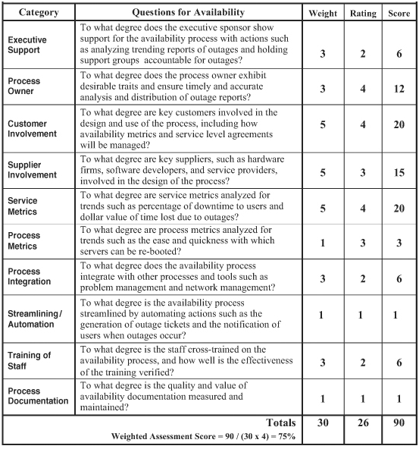
Assessing an Infrastructure’s Availability Process (Contd.)
Weights are assigned to each of the categories ranging from 1 for least important to 5 for most important, with a default of 3
The weight for each category is multiplied by its rating to produce a final score
An example worksheet with weightages is as seen below
The overall weighted assessment score is calculated by dividing this final score of 90 by the Maximum weighted score (MWS).
Maximum weighted score would be total weight * 4%
Notes:
Component Failure Impact Analysis (CFIA)
Fault Tree Analysis (FTA)
CCTA Risk Analysis and Management Method (CRAMM)
Service Outage Analysis (SOA)

Slide 35
Measuring and Streamlining the Availability Process
As discussed, we can measure and streamline the availability process with the help of the assessment worksheet
We can measure the effectiveness of an availability process with
Service metrics such as the percentage of downtime to users, dollars lost due to outages etc
Process metrics—Degree of automation, Ease and quickness with which servers can be re-booted—help us gauge the efficiency of the process.
We can then streamline the availability process by automating actions such as the generation of outage tickets whenever an online system goes down (rather than having service desk staff doing this) and by notifying users with automated voicemails and emails (if email is up) when outages occur.

Slide 36
Summary of the Activities Involved
Understand the definitions and terminologies involved in Availability Management
Understand the Availability requirements
Determine the metrics/measures of Availability
Use approaches as with the 7 Rs for building the process
Assessing an Infrastructure’s Availability Process
Using the metrics identified Identify approaches for streamlining the Process

Slide 37
Discussions
In your organization what do you see as the planning and activities which people do to ensure that new or changed services can support the expected SLAs and what are the kinds of measures which you would use
How do you go about assessing the risk of a process ..
Can you think about what are those things in the environment which people monitor
Notes:
Critical Success Factors (CSF)s and Key Performance Indicators (KPIs)

Slide 38
Discussions
What are those performance indicators which will indicate whether your availability of key processes in your organization is supported or not supported .. What kind of indicators which you would use and what are the Key Performance Indicators (KPIs) and CSFs (Critical Success Factors).
Notes:
Critical Success Factors (CSF)s and Key Performance Indicators (KPIs)

